Slide 1

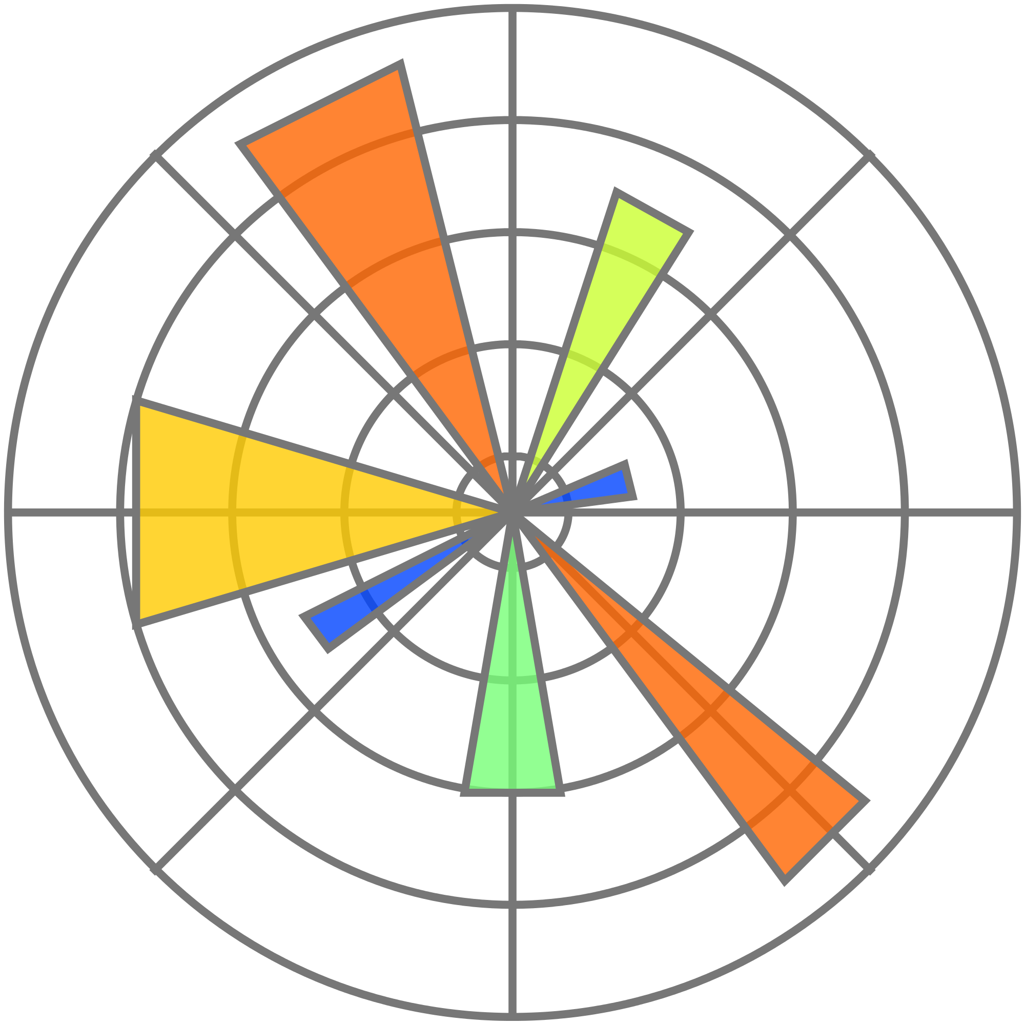
Matplotlib with python

Slide 2
Line
Legends titles and labels
Bar charts and histograms
Scatter Plots
Stack plots
Pie charts
Loading data from files
Getting data from the internet
Converting data from the internet
Basic customizations, rotating labels
Handling unix time
More customization of colors and fills
Spines and horizontal lines
Candlestick OHLC graphs
Styles
Live graphs
Annotations and placing text
Annotating last price to edge of matplotlib graph example
Subplots
Implementing subplots to our stock chart
Adding more indicator data to our charts
Cleaning chart, custom fills, pruning
Sharex axis
Multi y axis plotting volume on stock chart
Customizing matplotlib legends
Basemap intro
Basemap customization options
Plotting coordinates on a map with basemap
Matplotlib 3d intro
3d scatter plot
3d bar charts

Slide 3
Resources
Sentdex Videos and Code

